Slide 1
www.nevadaworkready.org

Slide 2
WorkKeys Assessments
Notes:
What are WorkKeys Assessments?
What is the NCRC?

Slide 3
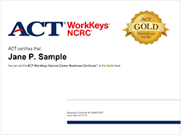
Certificate Levels and Workplace Implications
Notes:
Scoring a 3 or higher on all three assessments results in a National Career Readiness Certificate (NCRC)

Slide 4
Benefits for Employers
Reduces turnover
Improves hiring outcomes
Provides evidence of achievement beyond diploma or degree
Existing JobPro database identifies skill levels needed for specific occupations
Job Profiling can evaluate tasks related to specific position responsibilities and directly link required skills to WorkKeys scores

Slide 5
Benefits for Job-Seekers
Proves they possess skills needed for success in the workplace
Provides portable, nationally recognized work ready certificate
WorkKeys system offers curriculum for job-seekers to improve their skills and earn a higher level certificate

Slide 6
Benefits for Our Workforce System in Nevada
Quantifies development of a qualified and educated workforce
Establishes nationally validated identification of work ready skills
Collaborative effort by workforce development, economic development, education (k-12, adult/postsecondary), city and local government

Slide 7
Benefits for Educators
Provides nationally standardized measures of achievement for CTE programs
Supports student preparation for entry to postsecondary institutions and employment
Silver or higher NCRC provides potential college credit hours as recommended by the American Council on Education
Notes:
Craig Brockett will add/change this page…

Slide 8
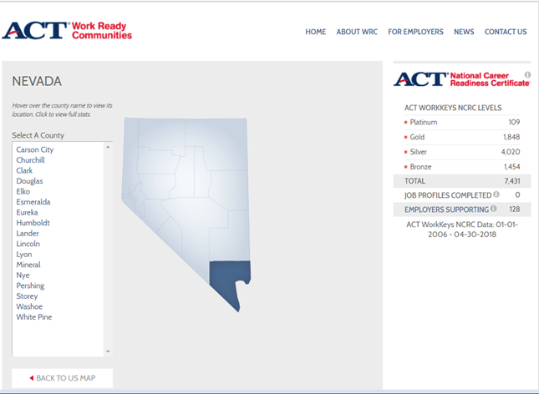
Clark County WorkReady Community
https://www.workreadycommunities.org/NV
Notes:
Go to current website and discuss Clark County Goals and then highlight where to go to support as an employer.

Slide 9
Contact Us
Ricardo Villalobos – Ricardo.Villalobos@csn.edu
Malik Williams – malik.Williams@csn.edu
Jill Hersha – hershaj@Lvccld.org
Craig Brockett – brockca@nv.ccsd.net

Slide 10
www.nevadaworkready.org

